Slide 1
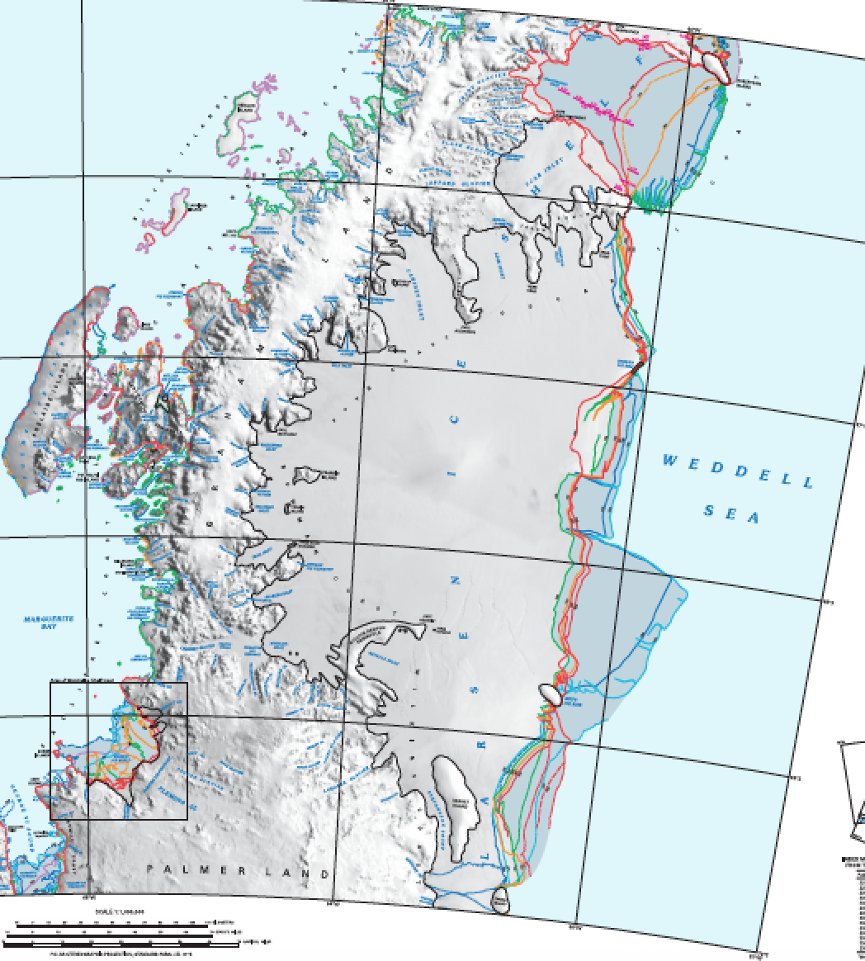

A ‘Family’ of Ice Shelves Called “The Larsens”
Larsen B
Larsen C
Supplementary image files for Ice Shelves Activity #2

Slide 2
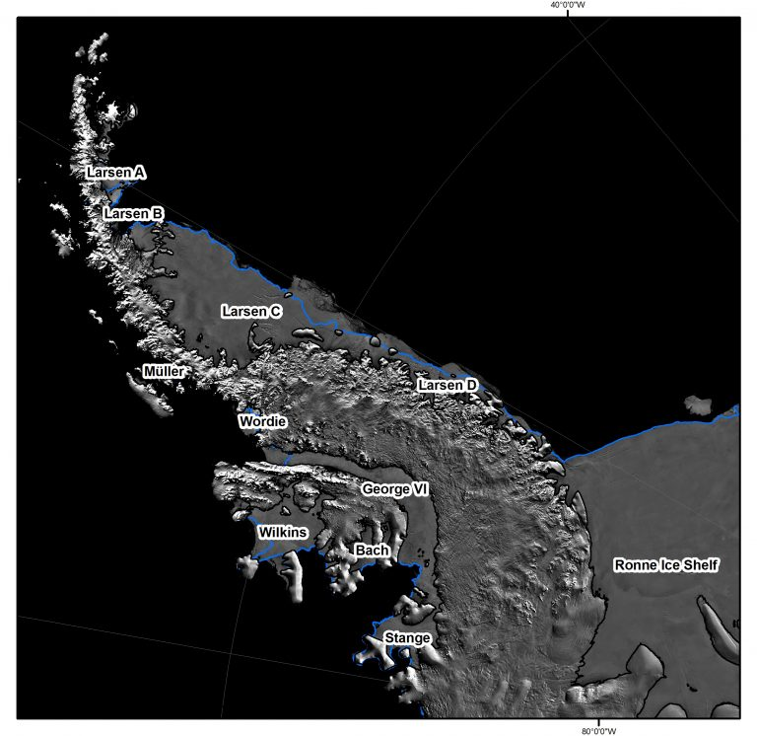
A look at some of the many ice shelves that border the Antarctic Peninsula

Slide 3
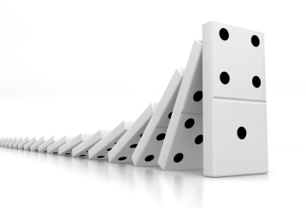
The Domino Effect
Ice shelves can behave like dominos. When they are lined up and the first one collapses it can cause a rippling effect like dominos. We have seen this with the Larsen ice shelves. Named in a series, the Larsen A, B and C and D shelves extended along the northeastern edge of the West Antarctic Peninsula, and as recently as 20 years ago covered a large section of coastline (Larsen E-G also exist but are much smaller). Bordering the western edge of the Weddell Sea, each extended from a separate embayment yet merged into a large expanse of ice, considered one ice shelf complex. All this was before 1995, before the dominoes began to collapse…

Slide 4

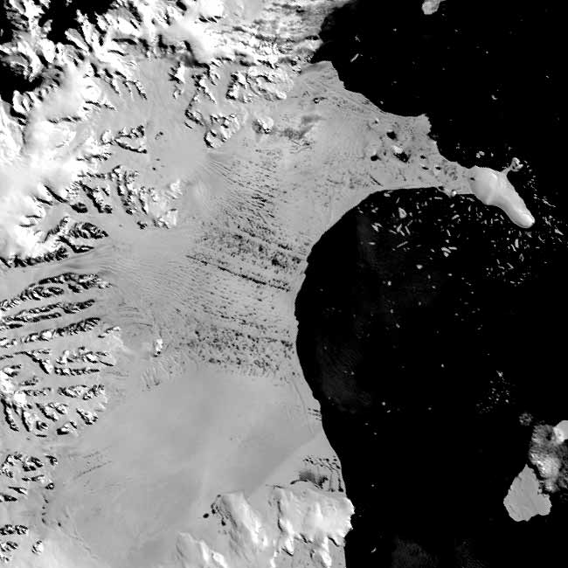
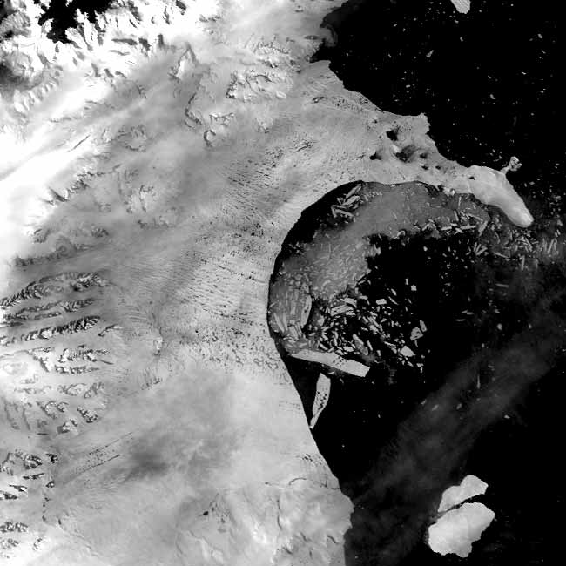
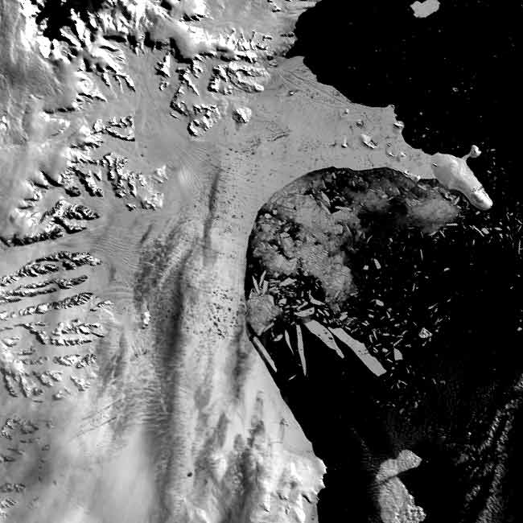
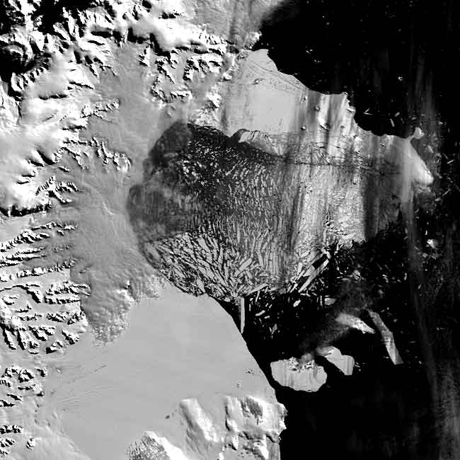
Causing a weakening & collapse of ‘ICE SHELVES’- buttress the ice sheet.
Antarctic Larsen B in 2002 - lost in just 6 weeks an ice shelf the size of Rhode Island

Slide 5
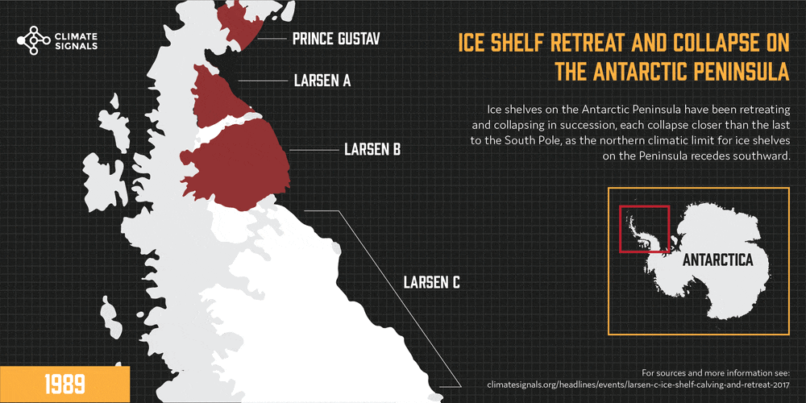
The Domino Effect, first one falls and then...
Follow the collapse of the iceshelves on the inside edge of the Antarctic Peninsula..
Note the dates in the bottom left of this visualization runs.

Slide 6
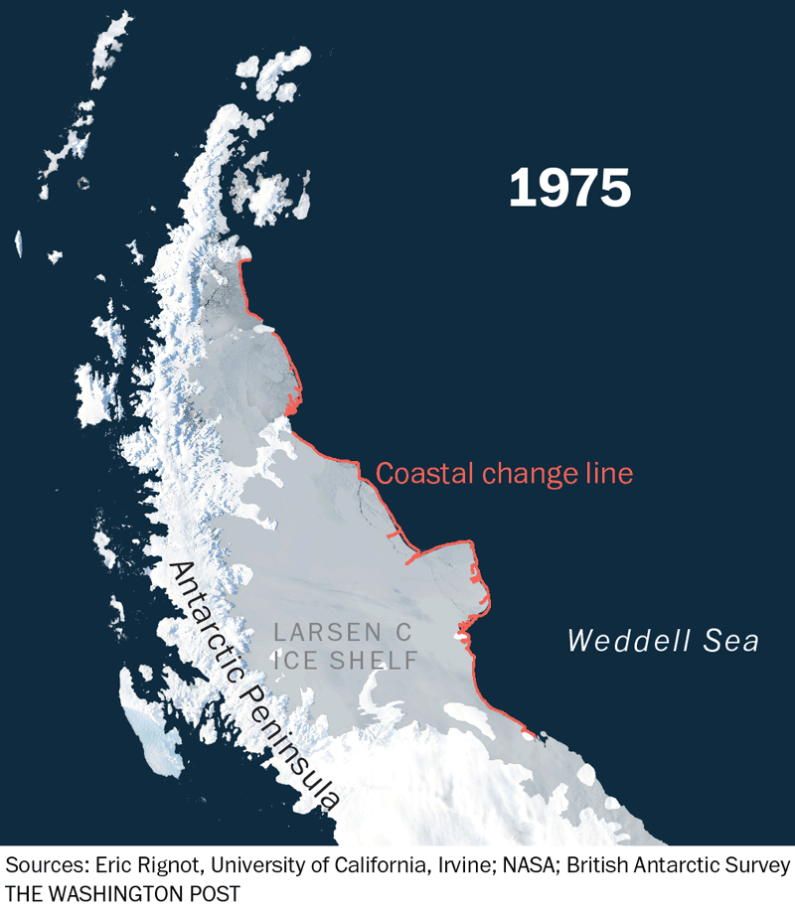
Focusing on the coastal change line

